Slide 1
Automating Parkinson's Disease Monitoring
Katherine Hemzacek
Springboard: Foundations of Data Science Workshop

Slide 2
Background – UPDRS Scores
Current gold standard: Unified Parkinson’s Disease Rating Scale (UPDRS)
Based on patient performance on many tasks
Motor (Speech, facial expression, tremor, fine motor, standing, posture, gait)
Mentation, Behavior, and Mood (Intellectual impairment, depression, motivation)
Activities of Daily Living (Swallowing, handwriting, handling utensils, dressing, walking)
Medical rater assigns scores
Indicates the level of disability present
Intended to capture a range of progression patterns

Slide 3
The Problem
Requires patients commute to test at a medical center
Large time commitment for rural patients
Rating dependent on medical opinion
Subjectivity of rating
Time required of medical professionals

Slide 4
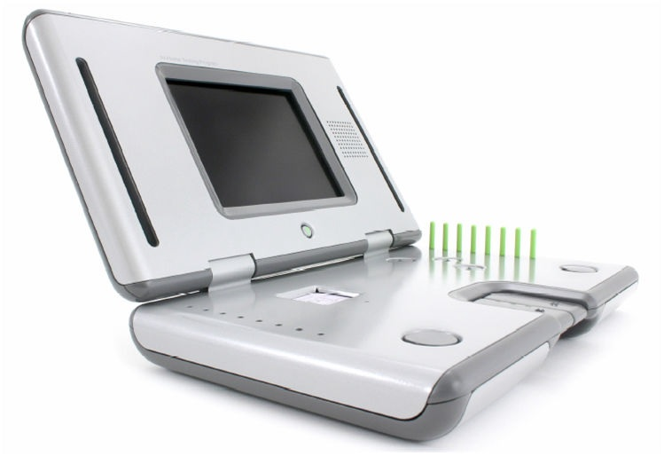
A Solution
At Home Testing Device (AHTD) developed by the Kinetics Foundation and Intel
+
Algorithm for automated interpretation of results

Slide 5
The Dataset
Oxford Parkinson's Disease Telemonitoring Dataset
UCI Machine Learning Repository
Athanasios Tsanas and Max Little of the University of Oxford
Signal characteristics of voice recordings taken with the AHTD
Sustained vowel phonation: “ah”
Recordings from feasibility study for AHTD
5,875 recordings
42 early-stage Parkinson’s patients
Span about 6 months
Once per week, patients took 6 recordings (4 normal-volume, 2 loud)
Notes:
Challenges – redundancy of 2/4 replicate recordings, non-independent due to small number of patients

Slide 6
Dataset Features
Subject Number
Time since trial recruitment
2 Demographics (sex, age)
2 UPDRS scores (motor, total)
16 signal attributes
5 Jitter variables (variation in fundamental frequency)
6 Shimmer variables (variation in amplitude)
NHR (Noise to Harmonics Ratio) and HNR (Harmonics to Noise Ratio)
3 Non-traditional signal characteristics: RPDE (Recurrence Period Density Entropy), DFA (Detrended Fluctuation Analysis), PPE (Pitch Period Entropy)
→ Days since trial recruitment & Time of day
+ Volume (from researchers)
Notes:
UPDRS interpolated between 0, 3, 6 months
NHR/HNR – turbulent airflow in vocal tract; RPDE - Hoarseness/creakiness; DFA – Breathiness; PPE – impaired pitch control

Slide 7
Averaging the Dataset
One observation per recording → One observation per day
Two Questions:
Should normal and loud recordings be considered replicates of each other or treated as distinct?
What should be done with days where a participant took more or less than the expected 6 recordings?

Slide 8
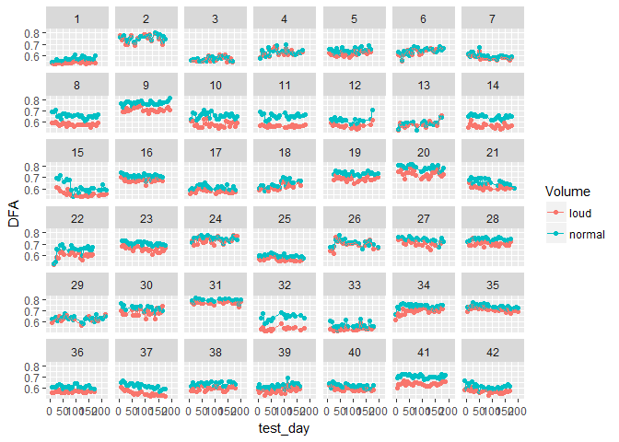
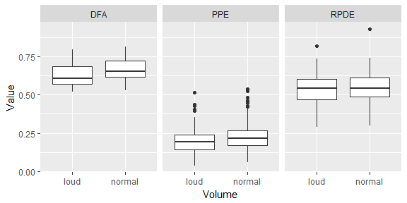
Normal/Loud Recordings
Notes:
Clustering, Plotting
Plotting informed final decision based on these two types of plots

Slide 9
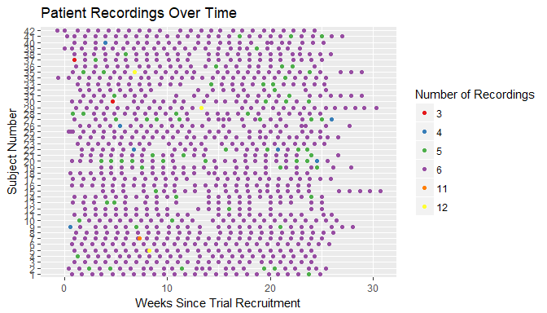
Number of Recordings/Day and Missing Data
Less than 6 : Were loud recordings present?
Missing data when averaged
More than 6: Should recordings be treated as two distinct data points?
Notes:
0 loud recordings – no loud data (2)
1 loud recording – no loud IQR data (23)
More than 6 – all averaged together

Slide 10
Averaging the Dataset
Starting Dataset
Averaged Dataset
Subject Number
2 Demographics (sex, age)
Test Day
Time of Day
2 UPDRS scores (motor, total)
16 signal attributes
+ volume
Subject Number
2 Demographics (sex, age)
Test Day
Median Time of Day
2 Median UPDRS scores (motor, total)
16 loud median signal attributes
16 loud IQR attributes
16 normal-volume median signal attributes
16 normal-volume IQR attributes
+ 2 counts, loud and normal recordings
Notes:
24 → 73

Slide 11
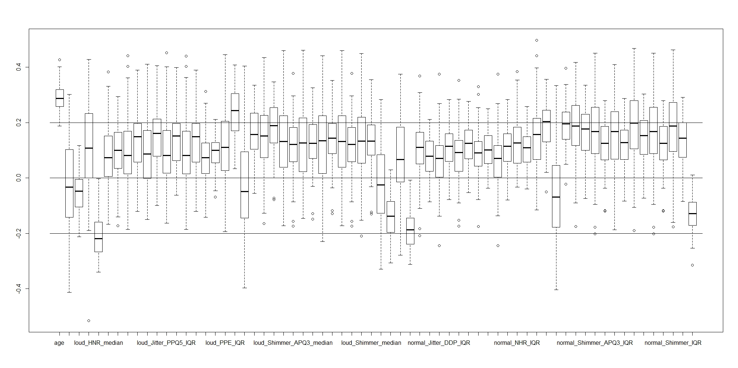
Variable Correlations

Slide 12
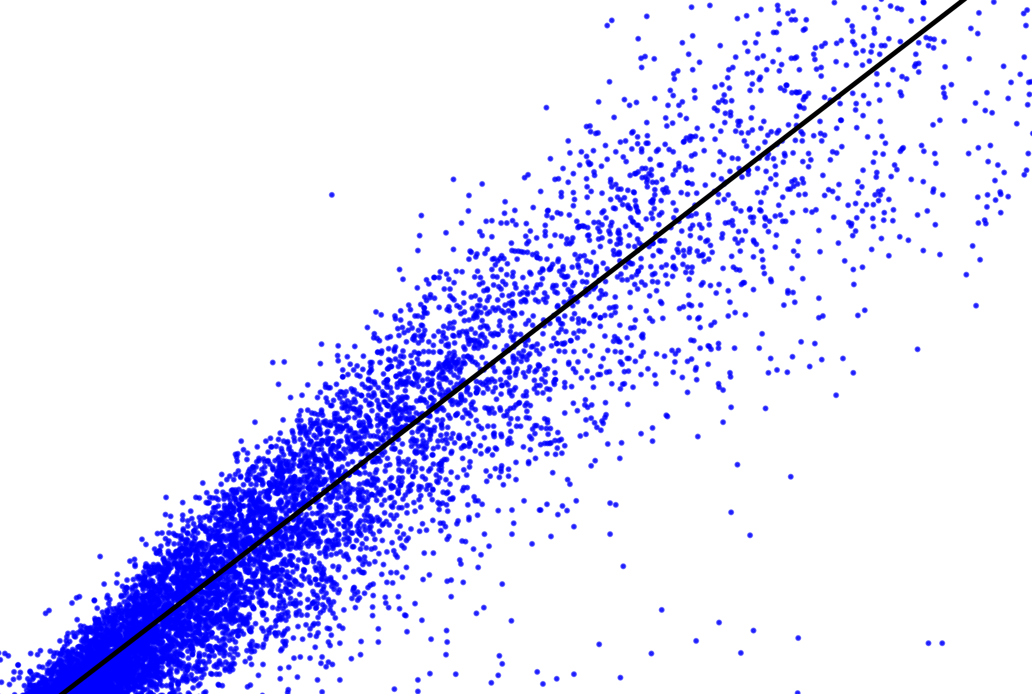
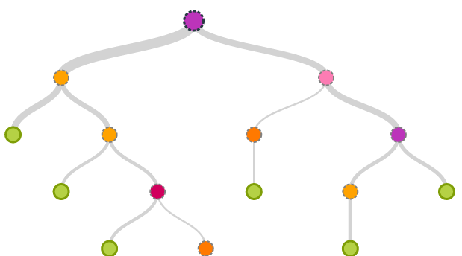
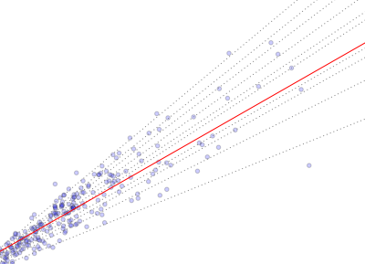
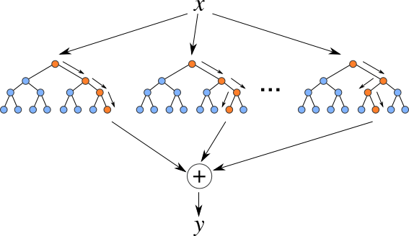
Machine Learning Approaches
Standard Models
Linear Regression
Regression Tree
Averaged Models

Slide 13
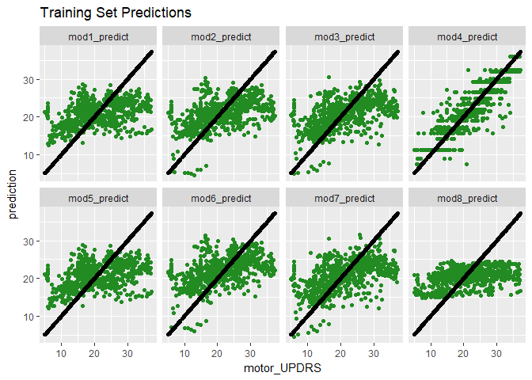
Comparing Performance – Train Set
Improved performance with increasing interaction terms
Standard/averaged linear regression models are comparable
Averaged regression tree model much worse than standard regression tree

Slide 14
Comparing Performance – Test Set
Model Type |  |  | R2 | within 2.5 | within 5.2
Standard | Linear Regression | Best Variables | 0.04849 | 18% | 40%
 |  | Less Interactions | 0.08970 | 23% | 42%
 |  | More Interactions | 0.1002 | 24% | 43%
 | Regression Tree | All Variables | 0.2498 | 39% | 56%
Averaged | Linear Regression | Best Variables | 0.04976 | 18% | 41%
 |  | Less Interactions | 0.1030 | 20% | 43%
 |  | More Interactions | 0.1006 | 24% | 43%
 | Regression Tree | All Variables | 0.06886 | 17% | 38%

Slide 15
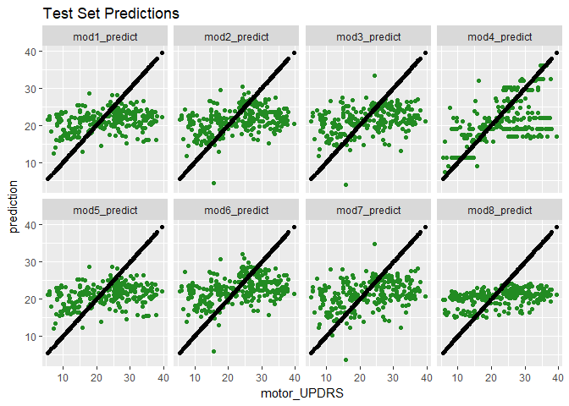
Comparing Performance – Test Set
Best model:
Standard Regression Tree

Slide 16
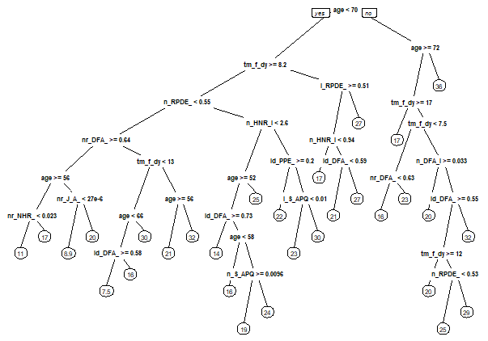
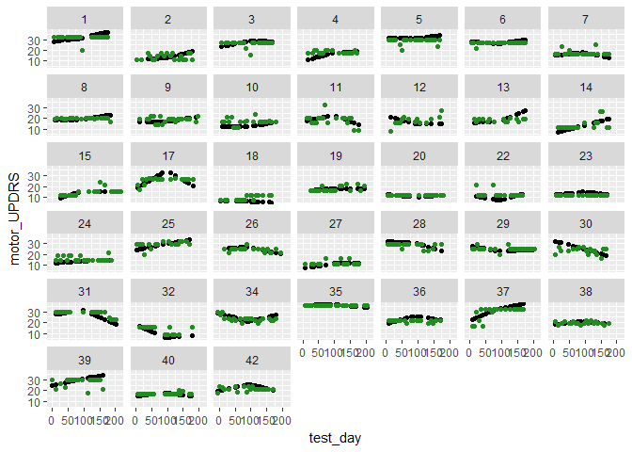
Regression Tree Model

Slide 17
Conclusion
Possibly implement standard regression tree for rapid, automated feedback to patients
Cannot base medical decisions on model predictions
However…

Slide 18
Improve Training Data
Base UPDRS prediction on the results of more tasks, or predict only speech task score
Utilize only UPDRS scores assigned by a medical professional, not interpolated scores
Collect data from a wider range of patients

Slide 19
Other Analysis Approaches
Other algorithms and model types
Time-series nature of the data
Patient-specific models
Explore feasibility
New signal characteristics
Non-traditional measures were good predictors

Slide 20
Thank You!!

